Slide 1
Experiment Summary
Experiment Name
: 2018-06-18 2377-009 TPP1 qPCR run 1
Experiment Type
: Standard Curve
File Name
: 2018-06-18 2377-009 TPP1 qPCR run 1.eds
Date Modified
: Mon Jun 18 13:01:24 EDT 2018
Date Created
: Mon Jun 18 11:17:54 EDT 2018
Run Started
: Mon Jun 18 12:43:31 EDT 2018
Run Finished
: Mon Jun 18 14:15:52 EDT 2018
Run Duration
: 92 minutes 21 seconds
User
:
Number of Wells Used
: 96
Number of Wells with Results
: 96
Instrument Name
: 278870909
Date Printed
: Jun 18, 2018
2018-06-18 2377-009 TPP1 qPCR run 1

Slide 2
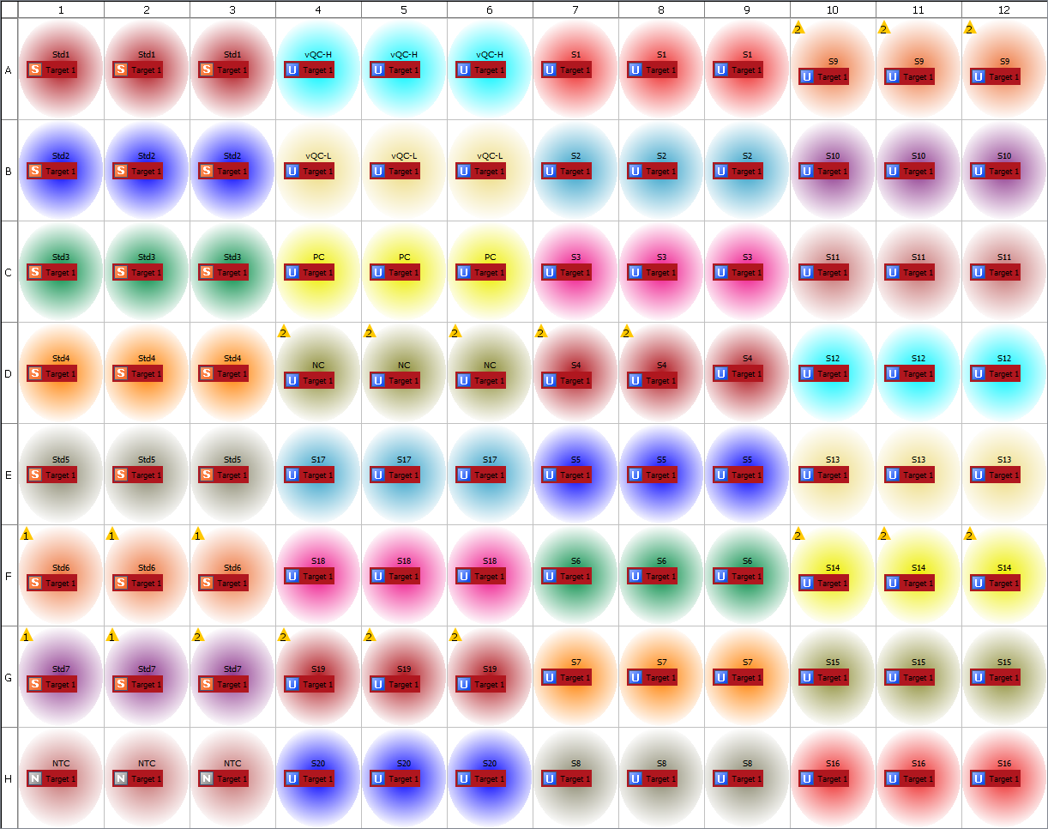
Plate Layout
2018-06-18 2377-009 TPP1 qPCR run 1

Slide 3
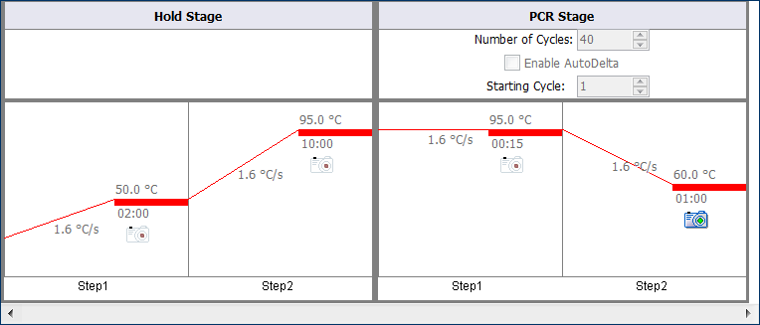
Thermal Method
2018-06-18 2377-009 TPP1 qPCR run 1

Slide 4
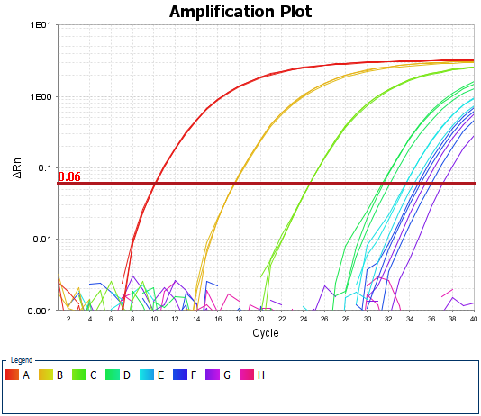
Amplification Plot
2018-06-18 2377-009 TPP1 qPCR run 1

Slide 5
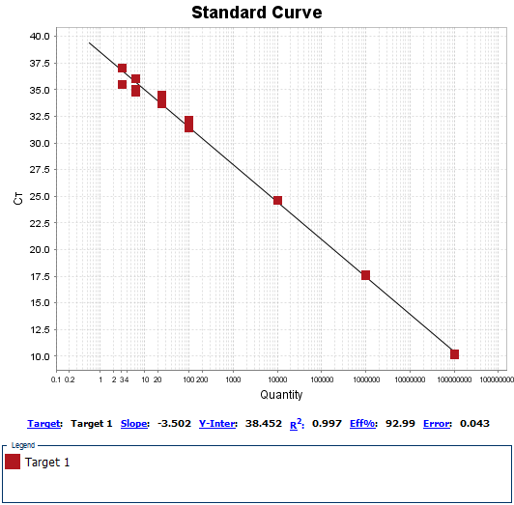
Standard Curves
2018-06-18 2377-009 TPP1 qPCR run 1

